Slide 1

Volcano Eruptions Prediction Model
Students:
Ram Michaeli, 318353364 Gal Israeli, 208416750 Yulia Kuderko, 321117863

Slide 2

research question
Research question
Can we predict how powerful will the next volcano eruption be?
What pattern can we observe and what conclusions can we learn from them?

Slide 3

Phases
3
Project phases
Data acquisition
Data cleaning
EDA
Machine Learning
Predict volcano type
Predict So2 emission of volcano
Prediction of next eruption strength
Conclusions

Slide 4
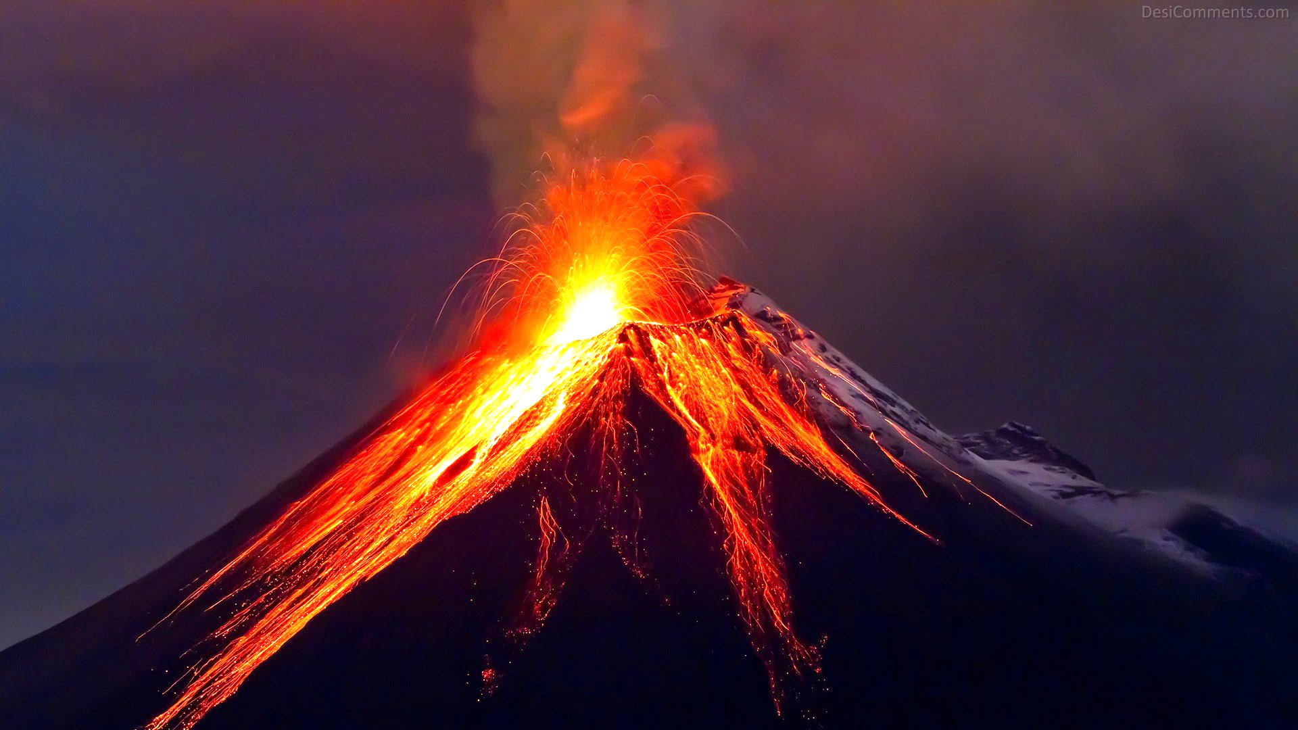
acquisition
data

Slide 5
crawling process
Data cleaning
Crawling
First, we used selenium in order to be able to click on the “submit eruptions” button that would lead us to the main url, which we needed to collect our data from.
We created lists for the features that eventually will be represented by columns in the final data frame.
Then, we used a loop that went through the pages using selenium library. Selenium allowed us to click the "next" button after every time we finished collecting the data from the current page.
We were able to extract all the relevant attributes and instances in each specific page using beautifulSoup library.
Each attribute was added to the lists we created in the beginning of the code.
Eventually, the data was exported to a csv file. This file is required in order to start analyzing our data in Jupyter notebook.

Slide 6
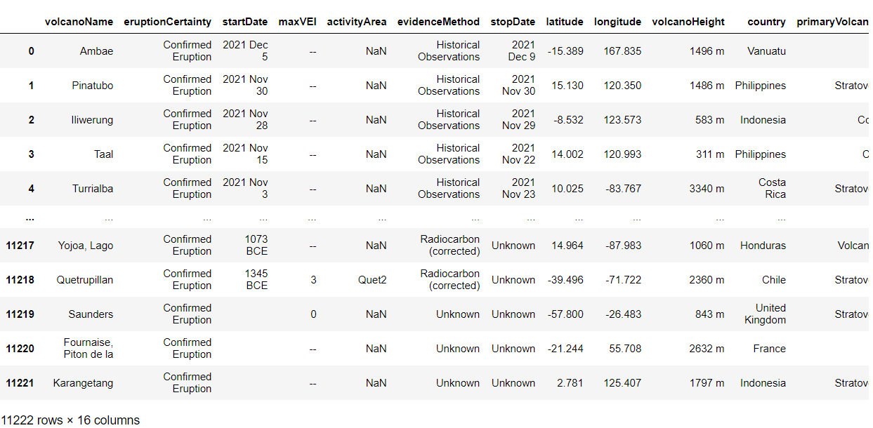
exported data frame
6
Data acquisition

Slide 7
Crawling resources
7
Data acquisition
Website that was used for the acquisition process
Packages that were used for crawling
BeautifulSoup, Selenium, pandas, requests
Amount of data that was collected (Raw data volume)
179,552 (before cleaning) ; 148,904 (after cleaning)
Smithsonian Institute - National Museum of Natural History
Minor packages: os, re, sys, time, warnings
Volcano name, Eruption certainty, Start date, Max VEI, Evidence method,
The attributes (columns)
Stop date, Latitude, Longitude, Volcano height, Country, Primary volcano
type, Population 5km, Population 10km, Population 30km, Population 100km

Slide 8
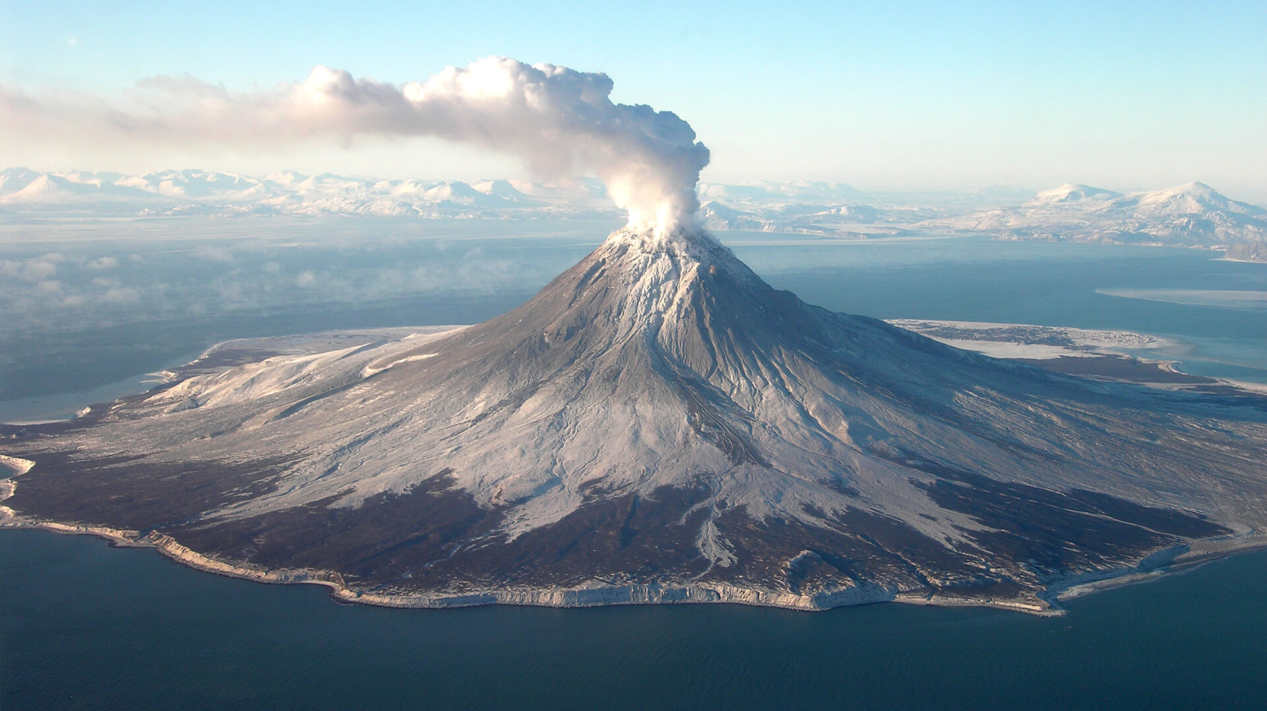
cleaning
data

Slide 9


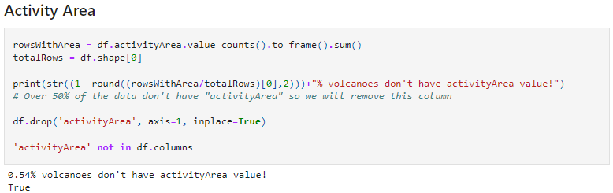
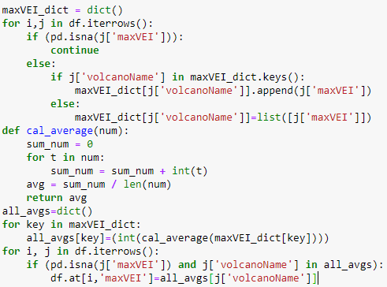
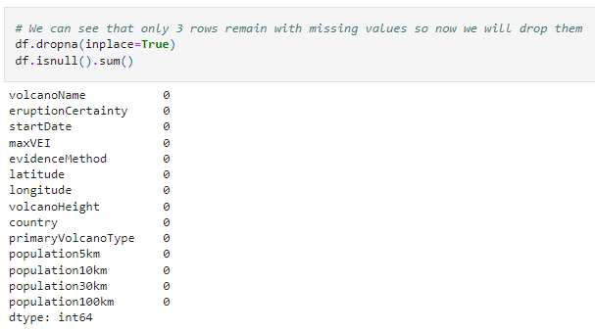
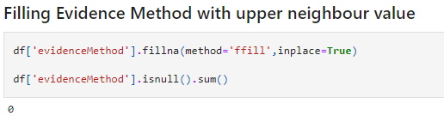
handling missing data
Data cleaning
Filling data (‘Max VEI’ and ‘Evidence Method’)
Dropping null values
Filling Max VEI with mean values. We took each volcano that had several eruptions, calculated their Max VEI averages and added them to the missing cells. Those who had no Max VEI history at all, were dropped completely.
“Activity Area” and “Stop Date” columns ware erased since more than a half of the data was empty. Therefore, these columns are irrelevant.
After taking care of all the cells, we dropped each row that contained missing values using the “dropna” method.
Filling ‘Evidence Method’ with upper neighbor value. We filled each missing cell with its neighbor’s value using the method: “ffill”.

Slide 10
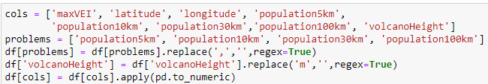
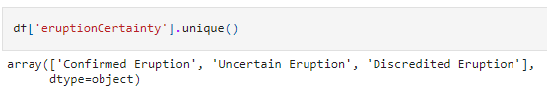
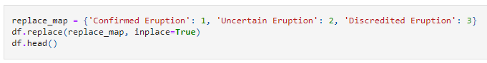
converting types
Data cleaning
Numeric Type
In order to change the ‘population’ columns to numeric values, we had to replace the coma character to an empty character and then we could switch to the desired type.
In addition, we had to replace the “m” letter to an empty character so there wouldn’t be a mix up between numeric characters and strings. After both of these actions, we could easily implement the appropriate type using the “to_numeric” function.
Categorical Type
As we can see, ‘Eruption Certainty’ has only three possible values: confirmed eruption, uncertain eruption and discredited eruption. Therefore, we changed their string values into numeric categorial so that our analyzation in the ML section would be more convenient.

Slide 11
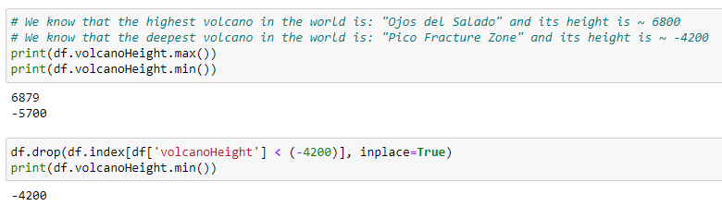

outliers
Data acquisition
Overall, we had almost all our data in its supposed range except for the “volcano height” column.
According to google, the deepest volcano in the world is -4200 meters, so we added the “drop” function in order to eliminate all the volcano heights that exceed this limitation.

Slide 12
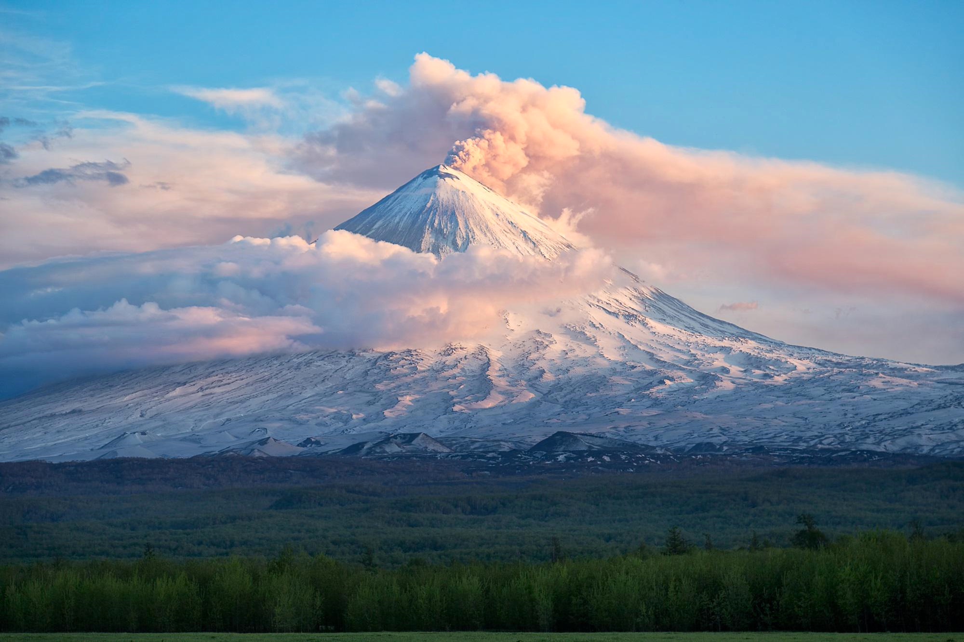
EDA

Slide 13
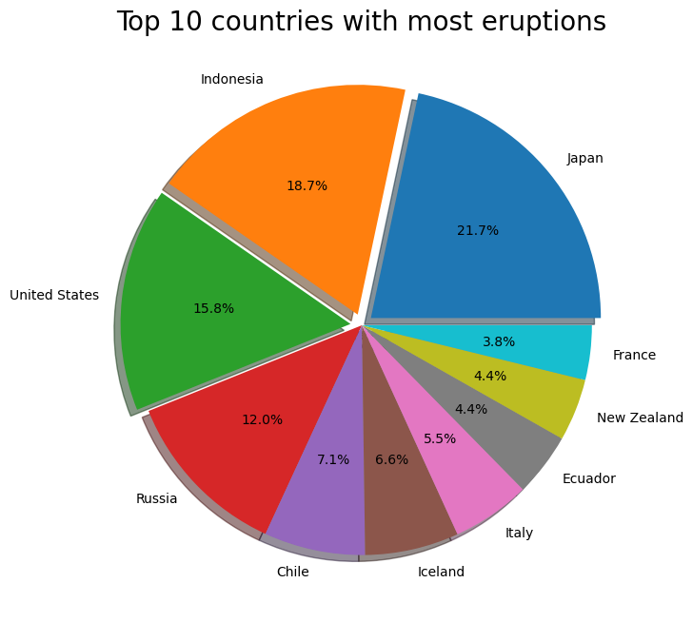
pie chart
13
EDA
Top countries
As we can see, Japan is the country with the biggest number of eruptive volcanoes.
On that note, Indonesia is in the second place and United States takes the third place.

Slide 14
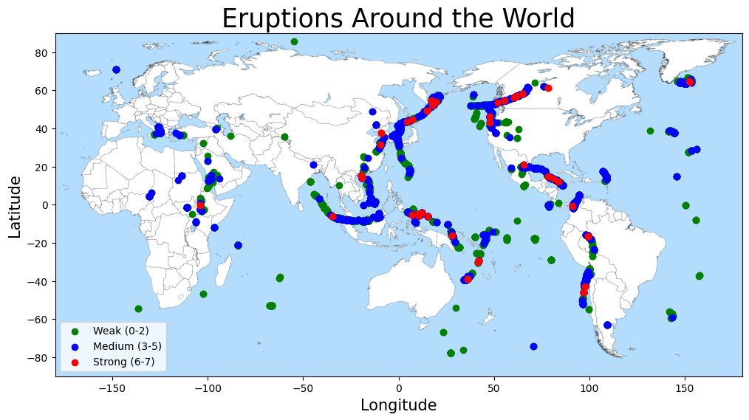
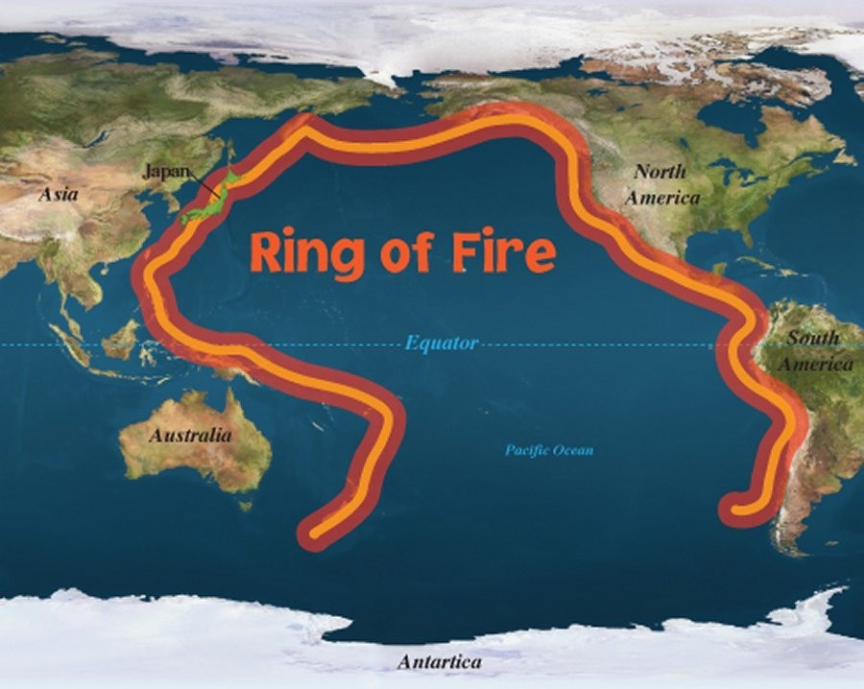
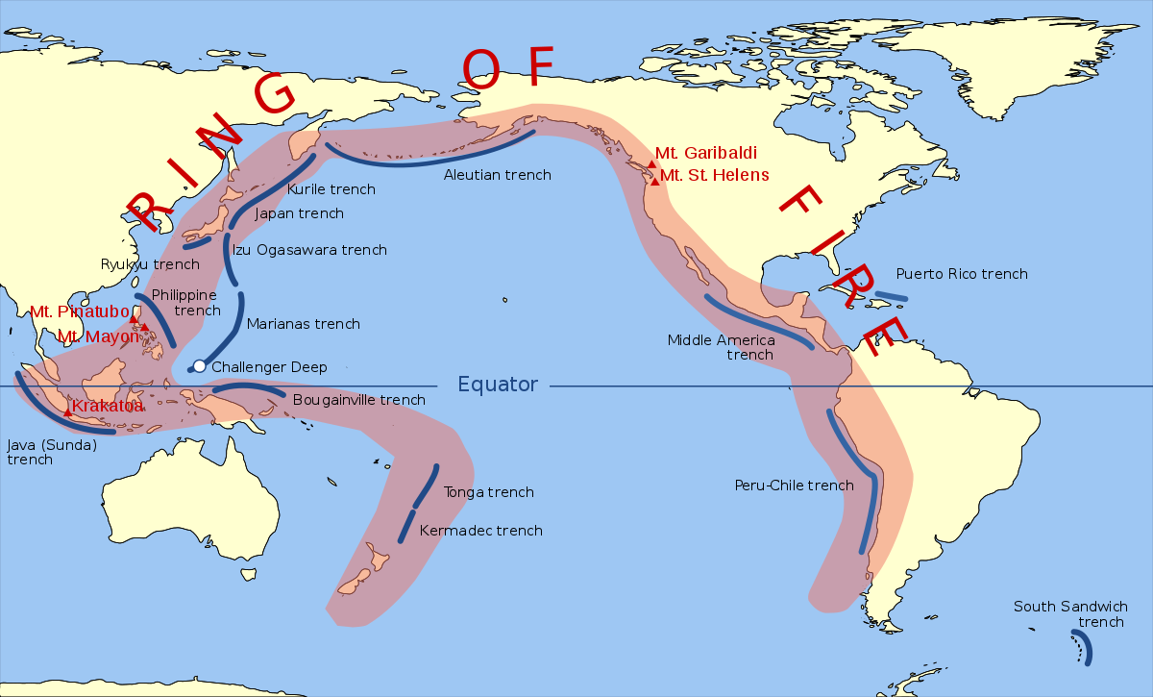
scatter plot
EDA
World Map
These are the locations of the volcanic eruptions. We can see that most of the eruptions indeed occur on the ring of fire as expected.
This is the ring of fire, which is a region where many volcanic eruptions occur.
The ring of fire is surrounded by these continents.
1
1
2
3
3
2

Slide 15
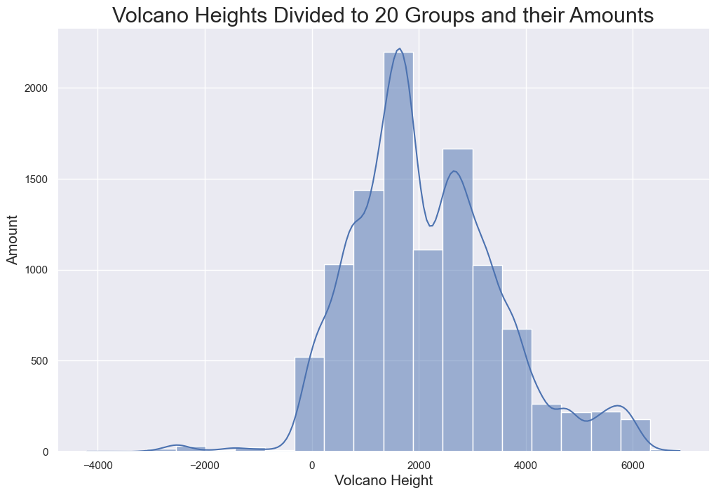
hist plot
EDA
This graph shows a division of volcano heights to 20 groups.
We can see that the most common volcano height is approximately between 1500 and 2000 meter.

Slide 16
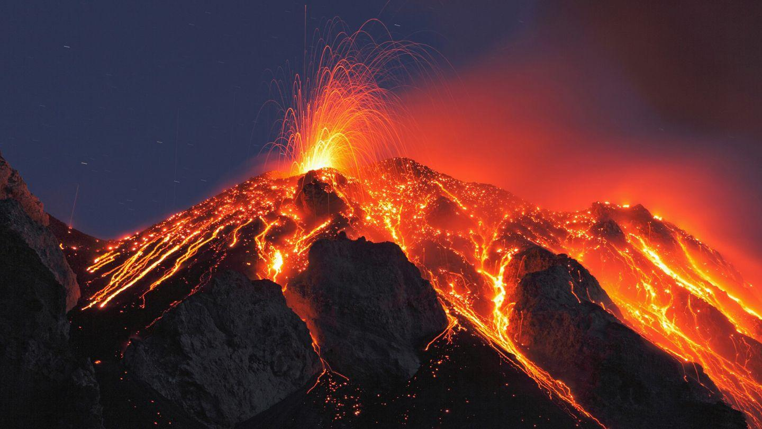
machine
learning

Slide 17
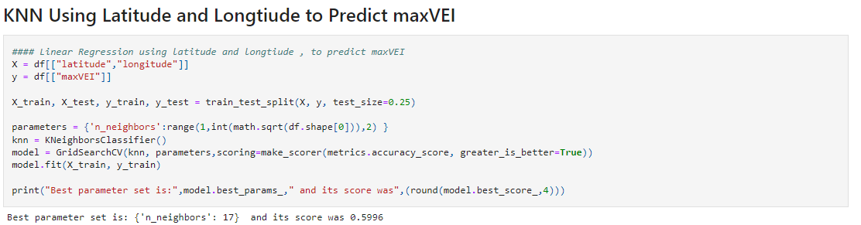
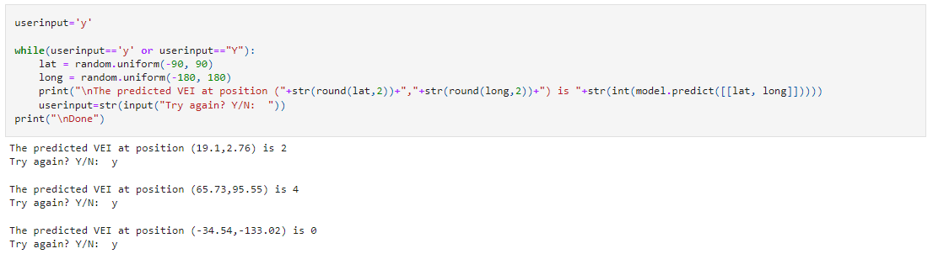
knn
Machine learning

Slide 18
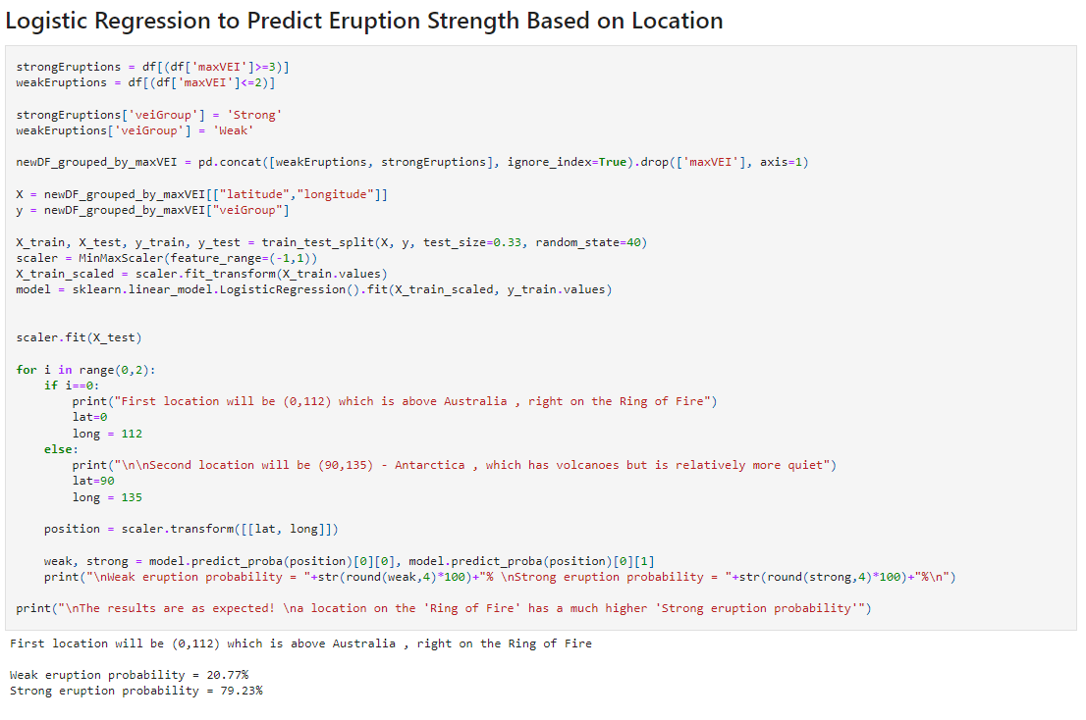
logistic regression
Machine learning

Slide 19
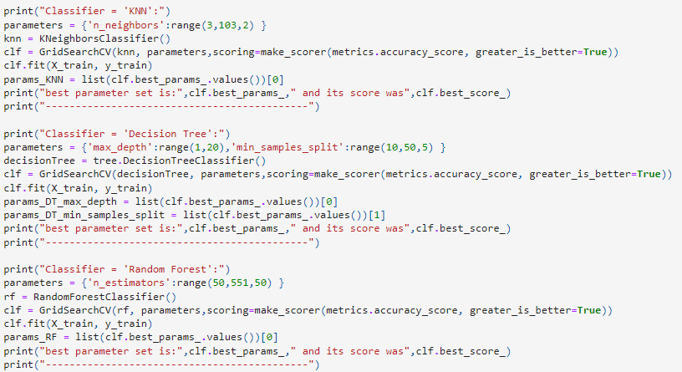
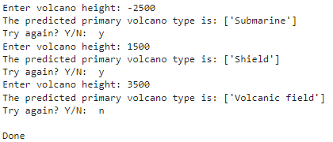
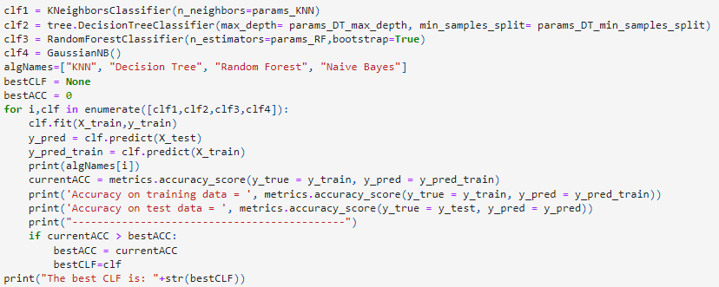
Multiple ml algos
19
Machine learning

Slide 20
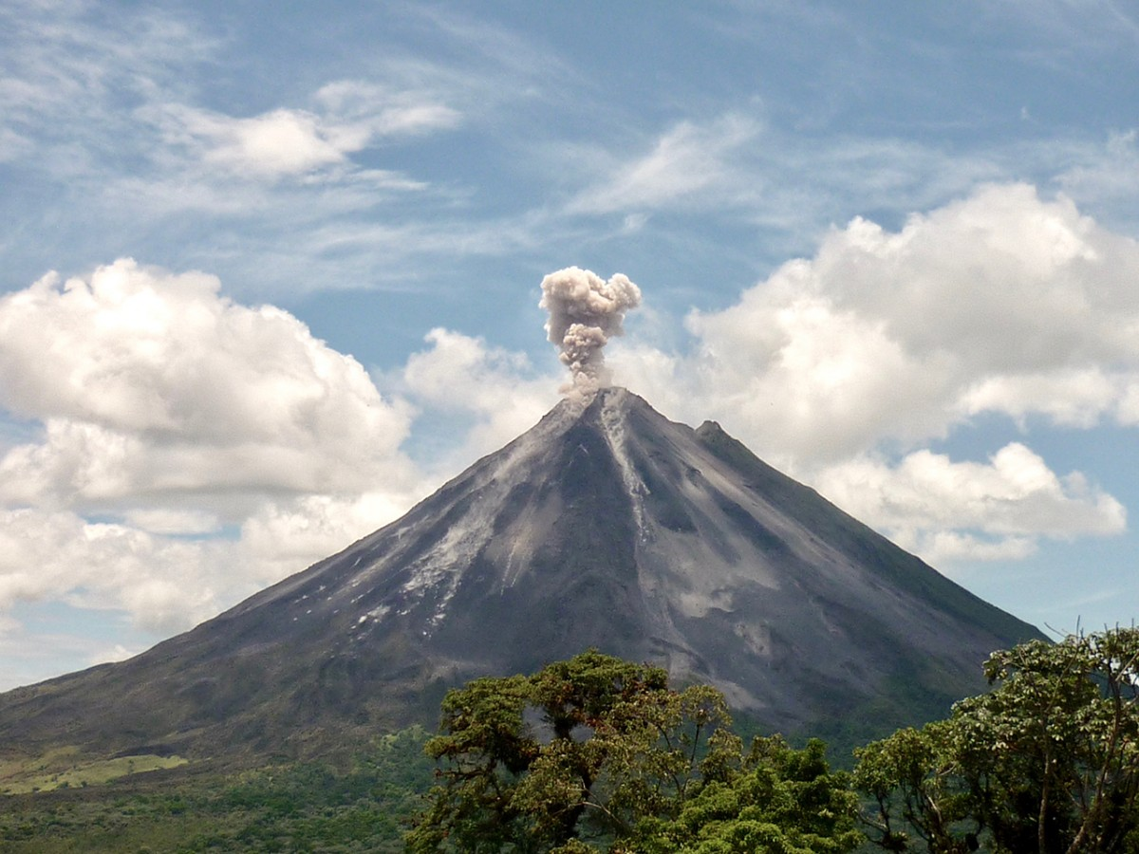
EFFECT
WOW

Slide 21
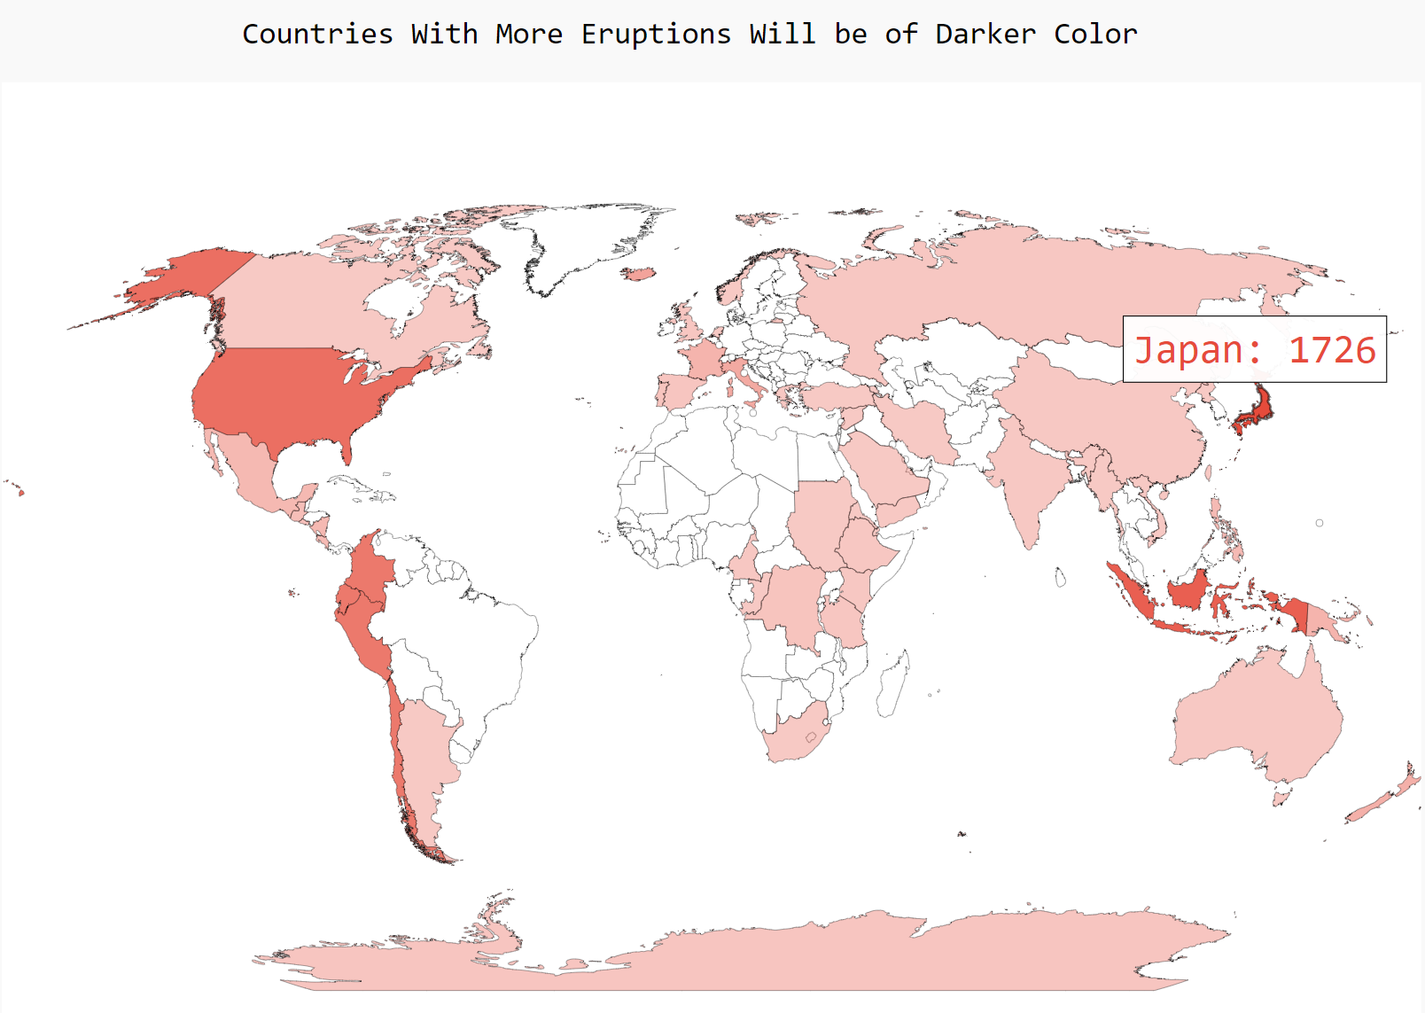
Wow Effect
Wow effect

Slide 22
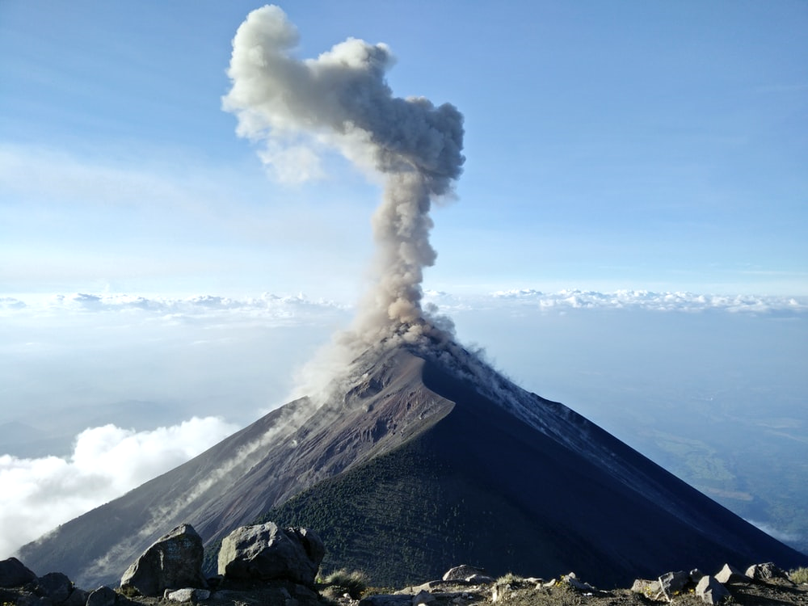
conclusions

Slide 23
conclusions
Data cleaning
Conclusions
We learned a lot about volcanic eruptions, observing and plotting the data teached us many interesting things , for example , that Japan is the leading country when it comes to eruptions amount. We learned how powerful machine learning can be, and how useful it can be when trying to find patterns in the data. We were able to predict the strength of the next eruption, as well as predicting volcano types based on their heights and also s02 emissions.

Slide 24
24
Thank you
Thank You !

